Slide 1
Course 2 Final Project
Responsive Static Website
Vojtech Kousal
Czechcouver

Slide 2
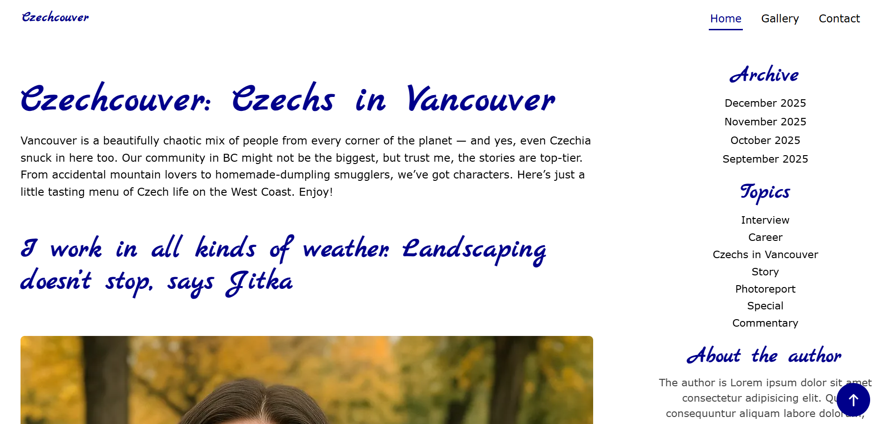
Responsive Web Development - Final Project
Vojtech Kousal - Czechcouver
My Project
1 of 32: Showcase your Website
Open your website on a browser, and answer these questions:
What is your website about?
What pages and content does it have?
How do you navigate through your website?

Slide 3
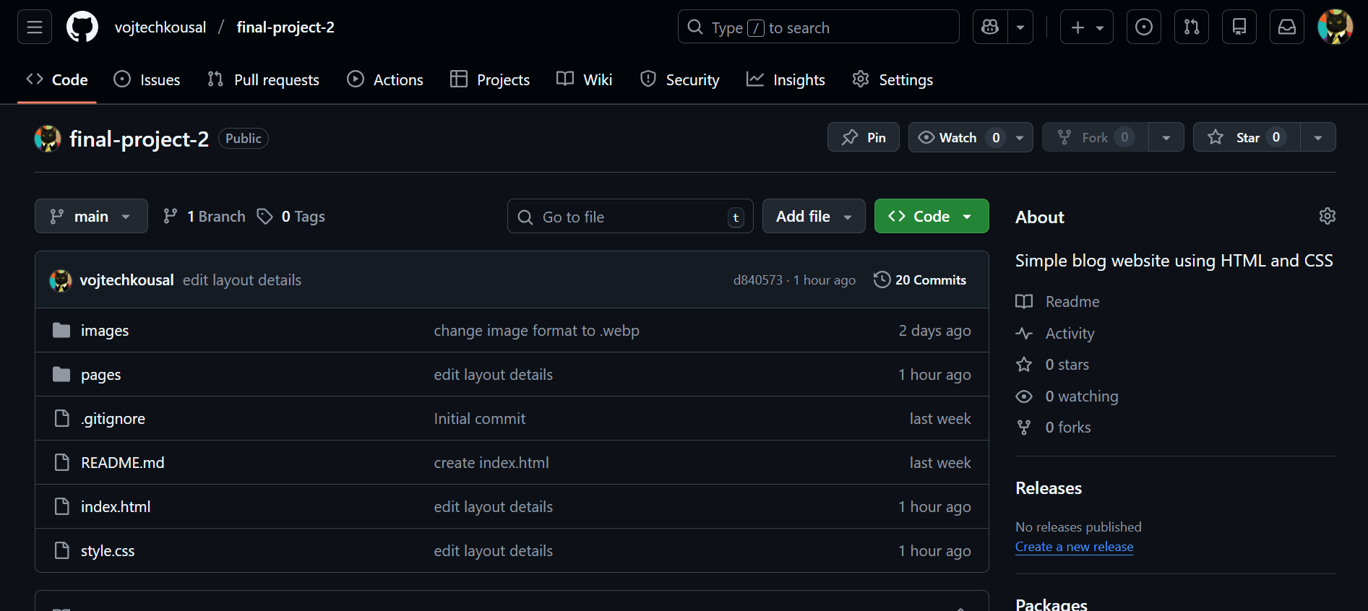
Responsive Web Development - Final Project
Vojtech Kousal - Czechcouver
GitHub Repository
2 of 32: Share your GitHub repository
Answer these questions:
Is your project on GitHub?
How can a potential employer check it out? (clone)
https://github.com/vojtechkousal/final-project-2

Slide 4
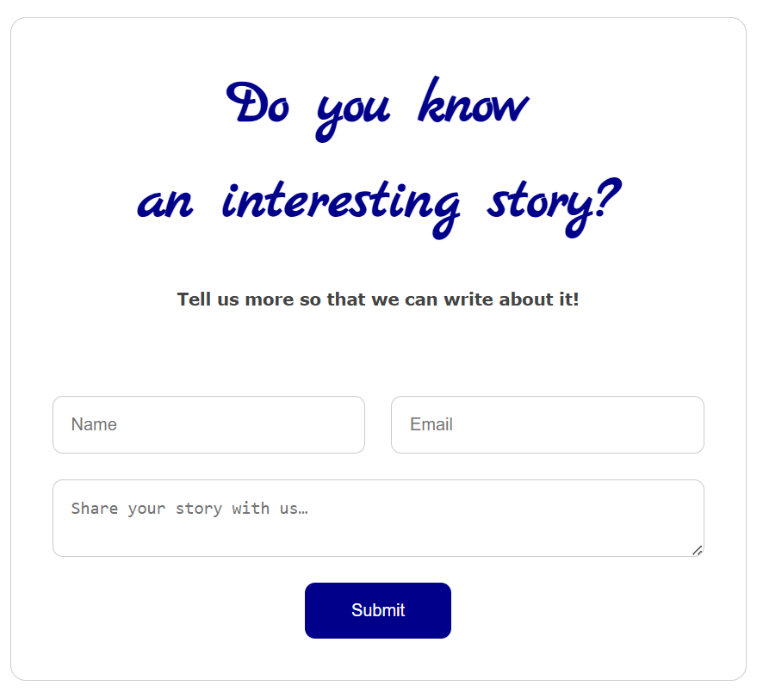
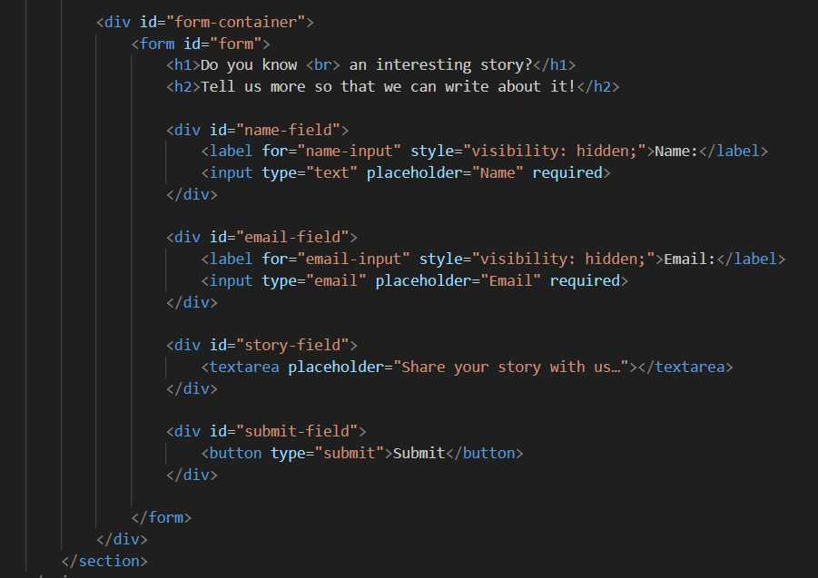
Responsive Web Development - Final Project
Vojtech Kousal - Czechcouver
HTML5 Form
4 of 32: Showcase HTML5 Form
Answer these questions:
Do you have a form element in your website?
How is the HTML of your form structured?
What input fields and labels does your form have?
What attributes are used in the elements of the form? And why?
Is there a button in the form?

Slide 5
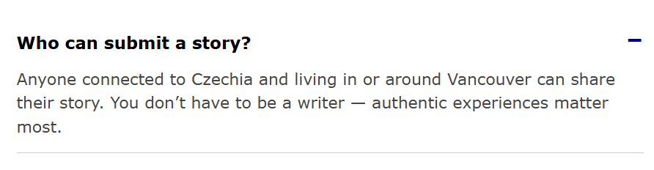
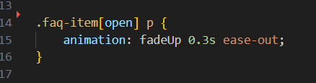
Responsive Web Development - Final Project
Vojtech Kousal - Czechcouver
Advanced CSS Selectors
5 of 32: Showcase Advanced Selectors
Answer these questions:
Can you show an example of at least one of the following?
Attribute Selector
Combinator Selector
Child or Sibling Selector

Slide 6
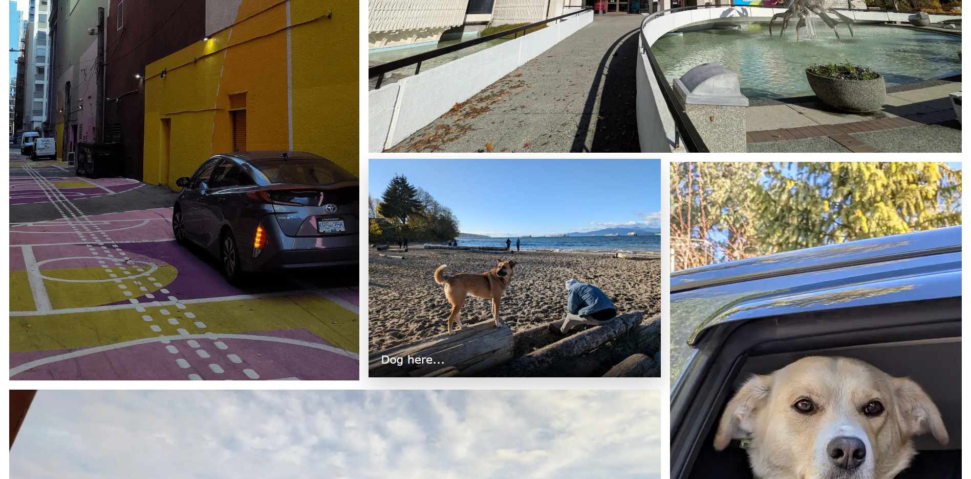
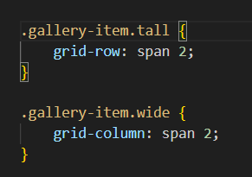
Responsive Web Development - Final Project
Vojtech Kousal - Czechcouver
CSS Selector Chaining
6 of 32: Showcase Selector Chaining
Answer these questions:
Can you show an example of selector chaining?

Slide 7
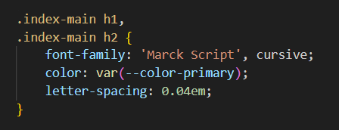
Responsive Web Development - Final Project
Vojtech Kousal - Czechcouver
CSS Selector Grouping
7 of 32: Showcase Selector Grouping
Answer these questions:
Can you showcase an example of how you used selector grouping?

Slide 8
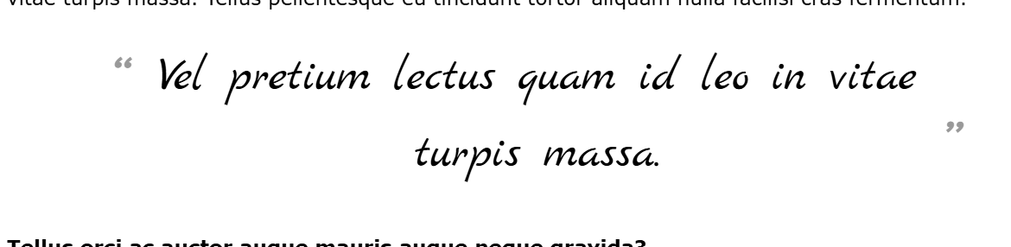
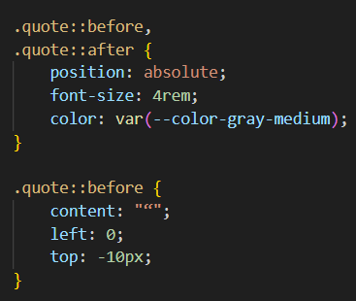
Responsive Web Development - Final Project
Vojtech Kousal - Czechcouver
CSS Absolute Positioning
8 of 32: Showcase Absolute Position
Answer these questions:
Can you show an example of an element with absolute positioning?

Slide 9
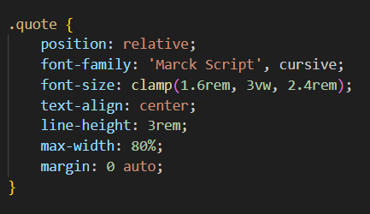
Responsive Web Development - Final Project
Vojtech Kousal - Czechcouver
CSS Relative Positioning
9 of 32: Showcase Relative Position
Answer these questions:
Can you show an example of an element with relative positioning?

Slide 10
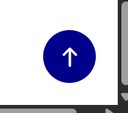
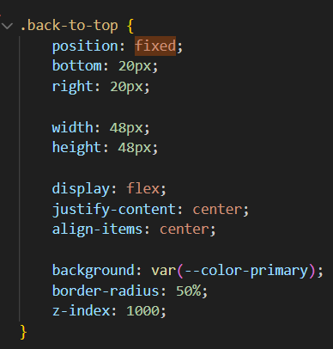
Responsive Web Development - Final Project
Vojtech Kousal - Czechcouver
CSS Fixed Positioning
10 of 32: Showcase Fixed Position
Answer these questions:
Can you show an example of an element with fixed positioning?

Slide 11
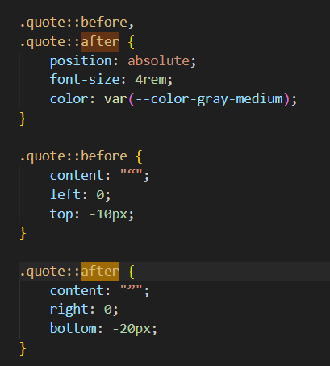
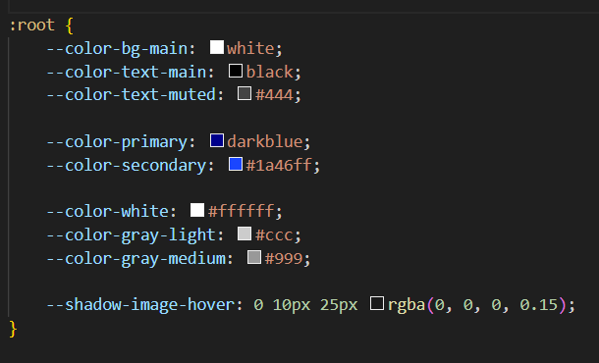
Responsive Web Development - Final Project
Vojtech Kousal - Czechcouver
CSS Variables
11 of 32: Showcase CSS Variables
Answer these questions:
Can you show an example of how you used CSS variables?

Slide 12
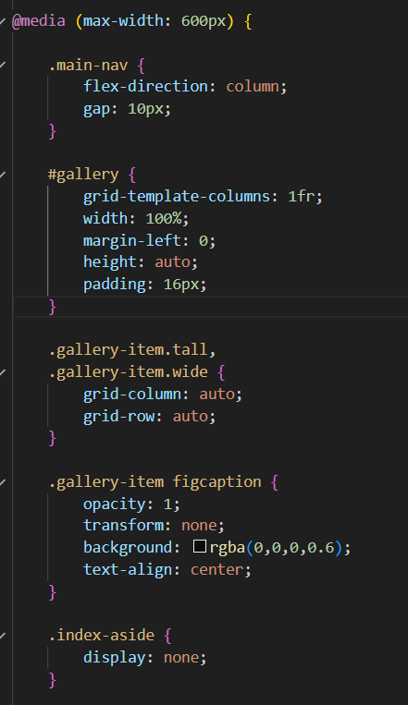
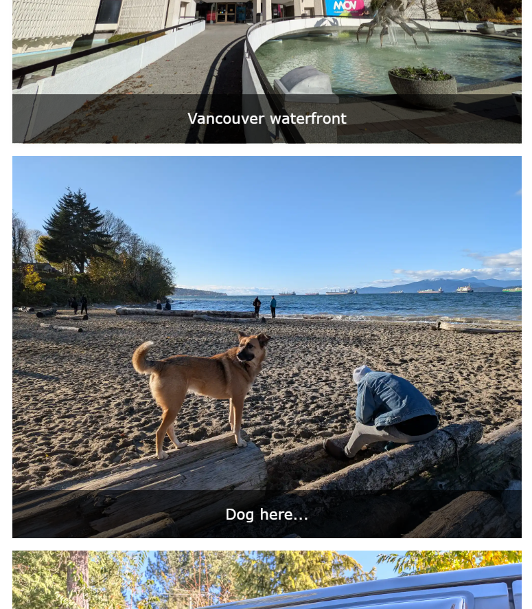
Responsive Web Development - Final Project
Vojtech Kousal - Czechcouver
CSS Media Queries
12 of 32: Showcase CSS Media Queries
Answer these questions:
Can you show how you used CSS Media Queries?
What breakpoints did you use?
What device features do you query for?
What conditions do your queries have?

Slide 13
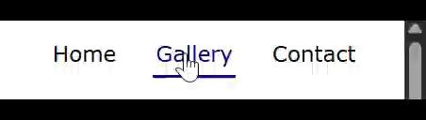
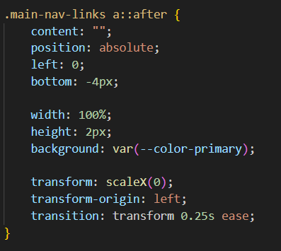
Responsive Web Development - Final Project
Vojtech Kousal - Czechcouver
CSS Transition
13 of 32: Showcase CSS Transition Property
Answer these questions:
Can you show an example of the transition property used in your project?

Slide 14

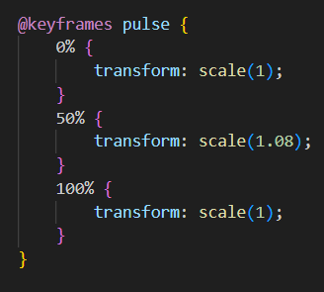
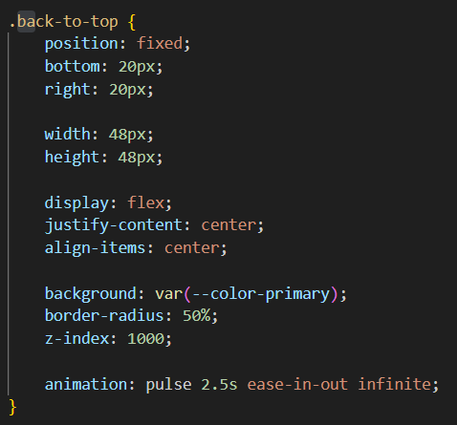
Responsive Web Development - Final Project
Vojtech Kousal - Czechcouver
CSS Keyframe Animations
14 of 32: Showcase CSS Keyframe Animations
Answer these questions:
Do you have an example of a keyframe animation in your project?
Which animation properties did you use?

Slide 15
Responsive Web Development - Final Project
Vojtech Kousal - Czechcouver
CSS Pseudo-Elements
15 of 32: Showcase CSS Pseudo-Elements
Answer these questions:
Can you show an example of at least one pseudo-element used in your project?

Slide 16
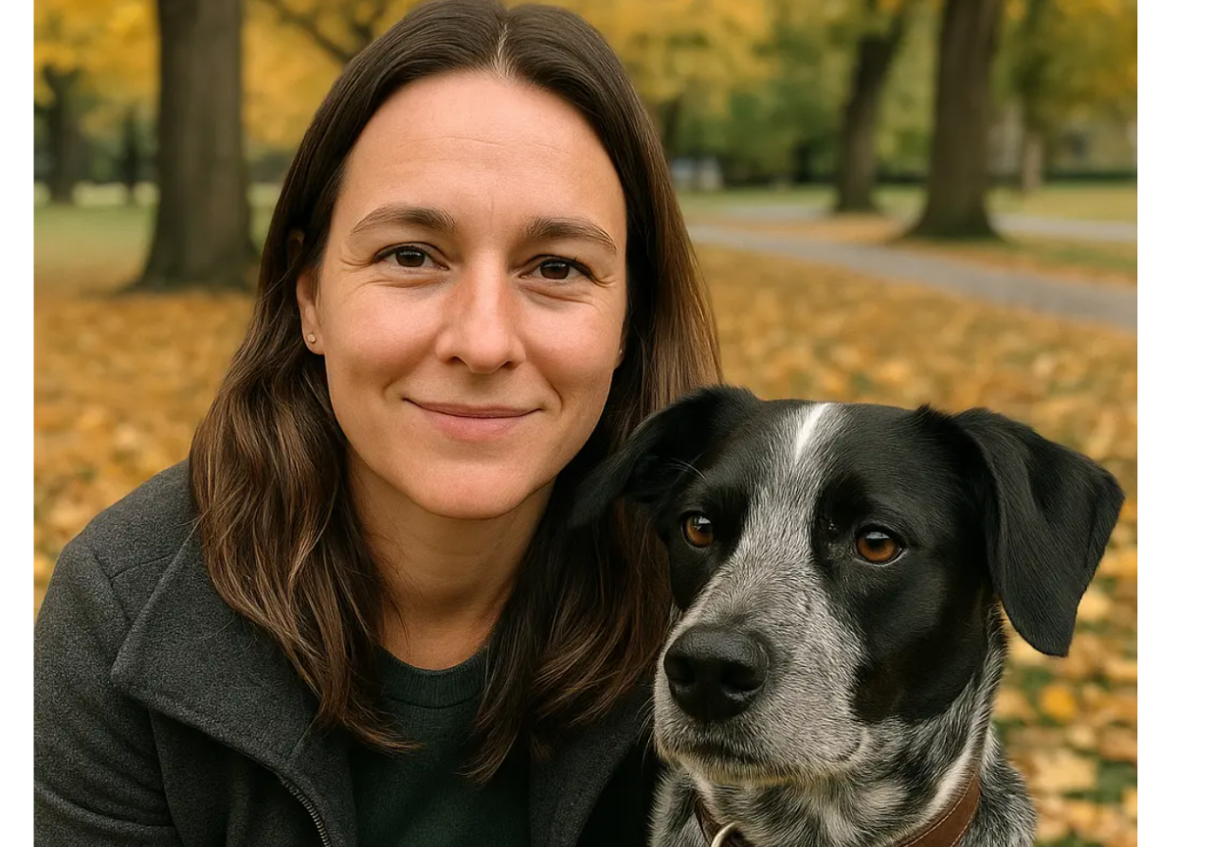
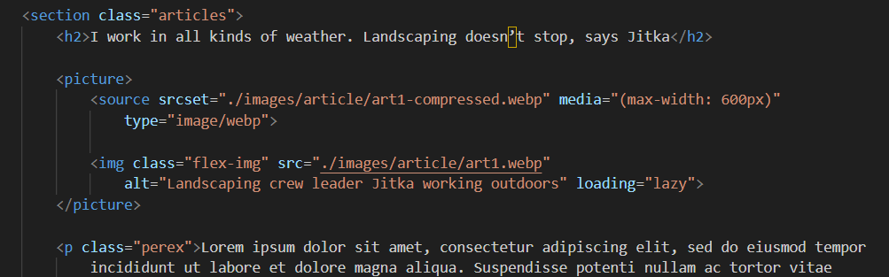
Responsive Web Development - Final Project
Vojtech Kousal - Czechcouver
Flexible Images’ HTML
16 of 32: Showcase Flexible Images HTML
Answer these questions:
Did you use <picture> and <source> for your <img> elements?
How did you use the srcset attribute for <source>?
Do your <img> elements have proper alt attributes?
What other attributes did you use for the <picture>, <source> and <img> elements?

Slide 17
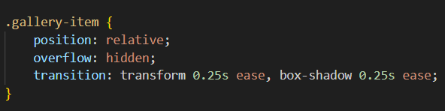
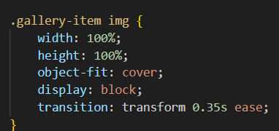
Responsive Web Development - Final Project
Vojtech Kousal - Czechcouver
Flexible Images’ CSS
17 of 32: Showcase Flexible Images CSS
Answer these questions:
How do you maintain aspect ratio of images?
How do you prevent images from getting distorted (squished or stretched)?
How do you prevent images from overflowing?

Slide 18
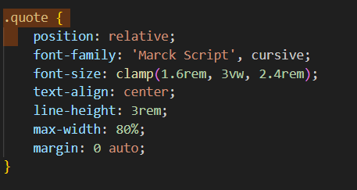
Responsive Web Development - Final Project
Vojtech Kousal - Czechcouver
CSS Units
18 of 32: Showcase CSS Units
Answer these questions:
Can you show examples of how you use Relative Units for Responsive Design in your project?
Did you use % and/or viewport units? How?

Slide 19
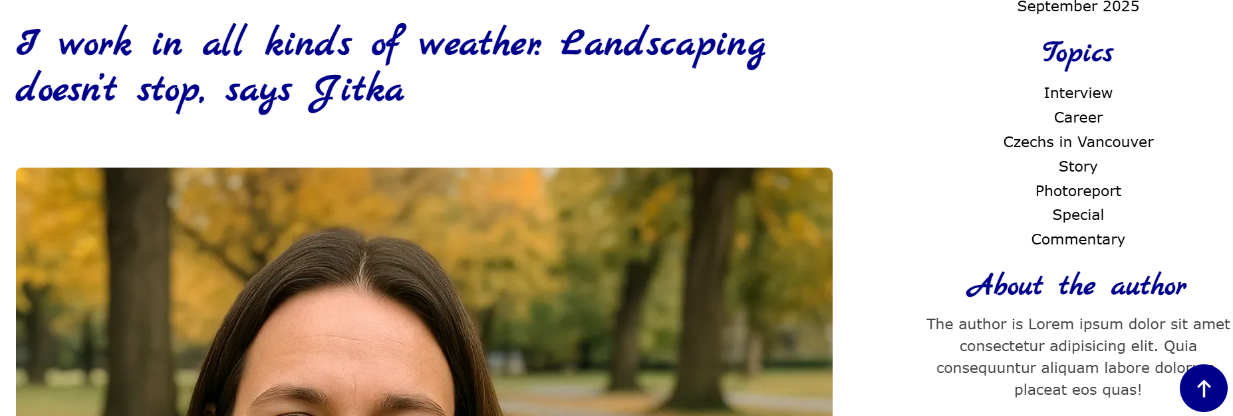
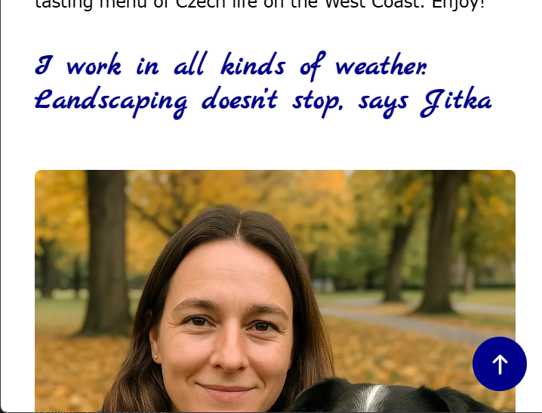
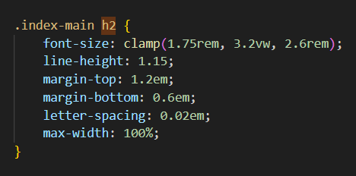
Responsive Web Development - Final Project
Vojtech Kousal - Czechcouver
Responsive Typography
19 of 32: Showcase Responsive Typography
Answer these questions:
Can you show an example of how you achieve responsive typography in your project?
Did you use em and rem units?
What font-sizes are you using and why?

Slide 20
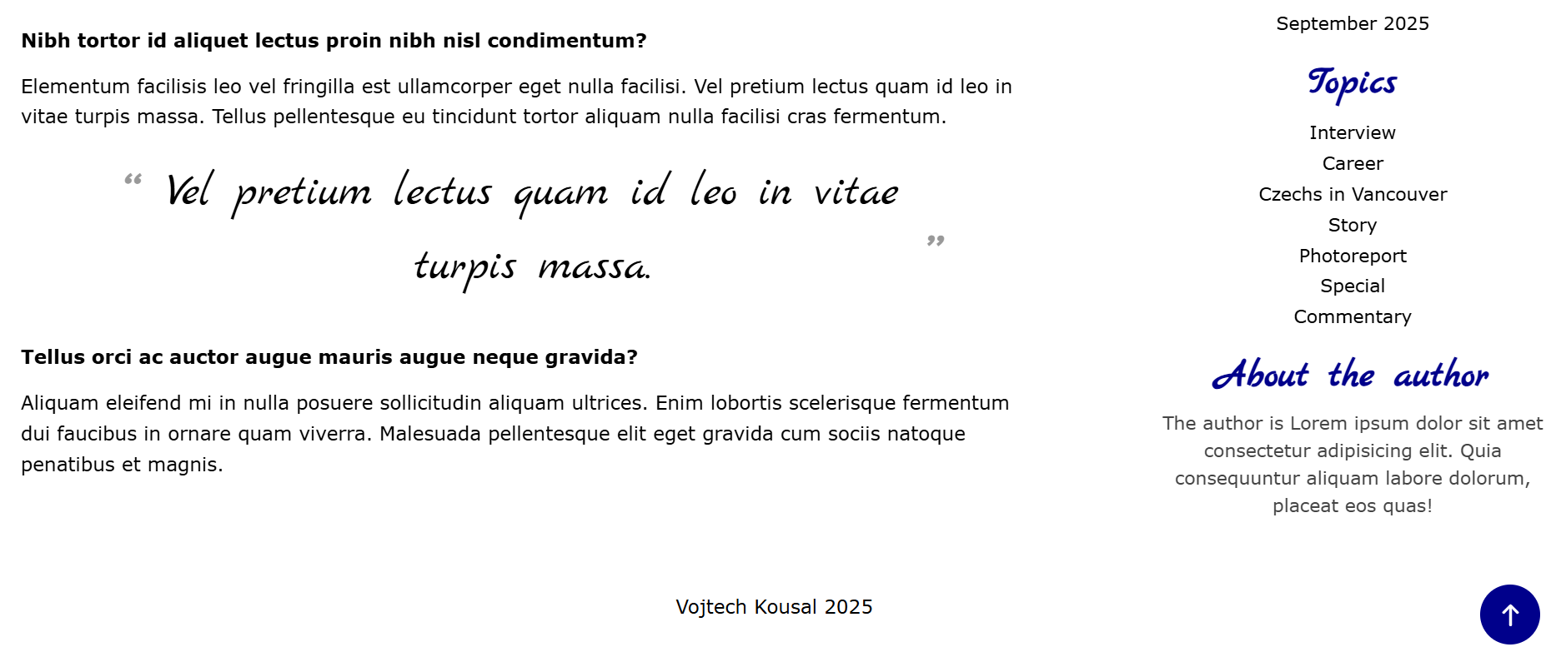
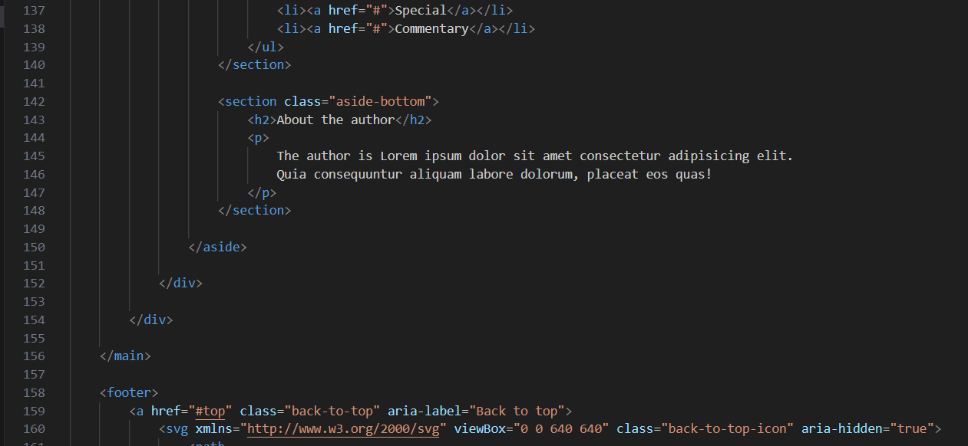
Responsive Web Development - Final Project
Vojtech Kousal - Czechcouver
Semantic Sections Markup
20 of 32: Showcase Semantic Section Tags
Answer these questions:
Can you show how you used <div> elements only for non-semantic sections?
Can you show how you used semantically meaningful tags for your page sections?
Did you use <header>, <nav>, <main>, and <footer>?
Did you use <section> with aria role and label?
Did you use <aside>? (optional)

Slide 21
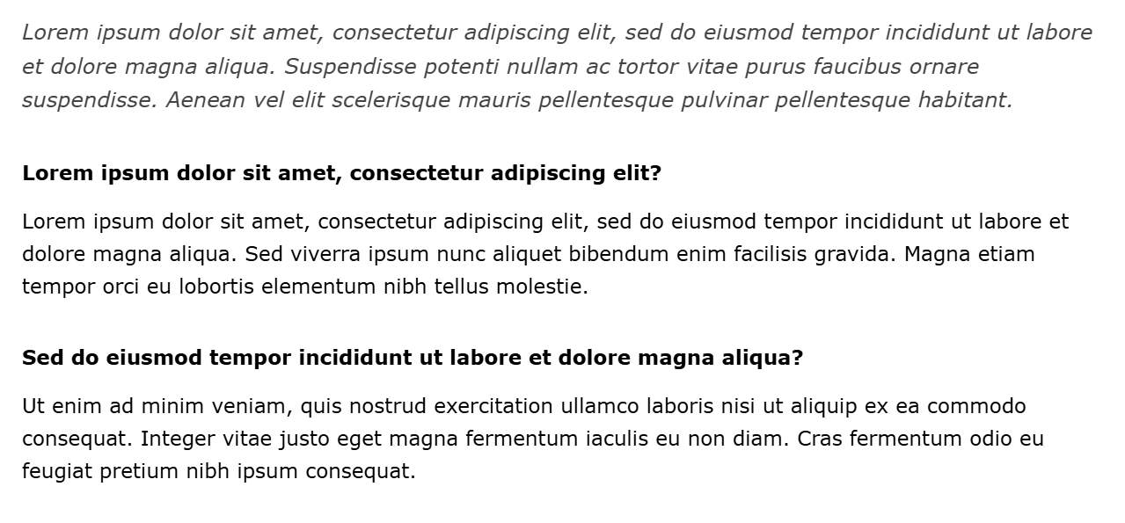
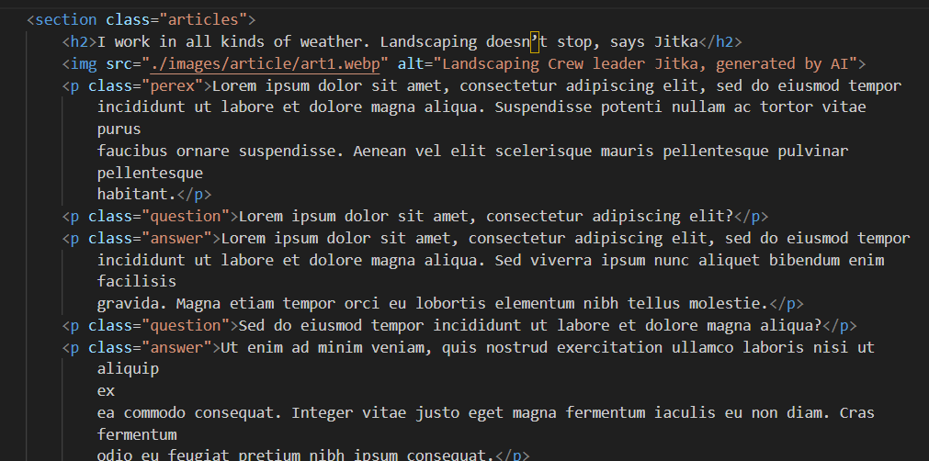
Responsive Web Development - Final Project
Vojtech Kousal - Czechcouver
Semantic Content Markup
21 of 32: Showcase Semantic Content Tags
Answer these questions:
Can you show how you used semantically meaningful elements instead of non-semantic ones? For example:
<strong> instead of <b>
<em> instead of <i>
Text inside <p>, <a>, and headings

Slide 22
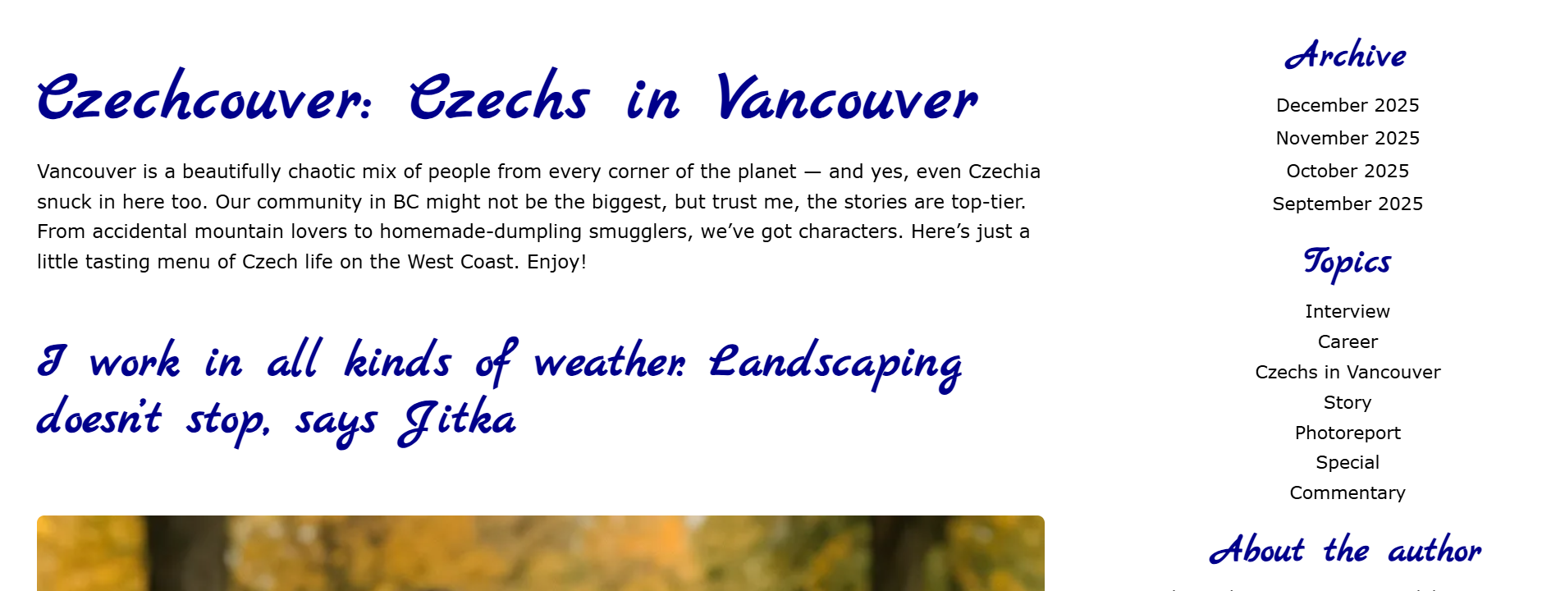
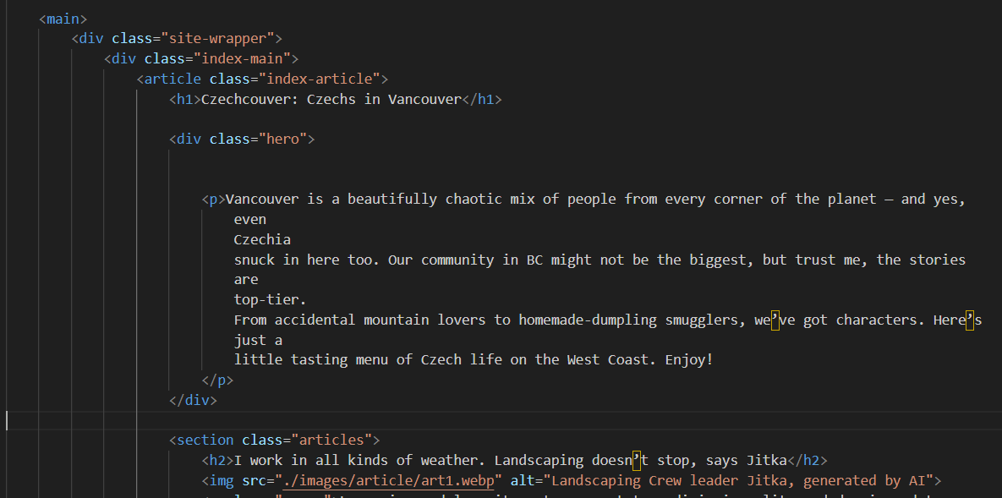
Responsive Web Development - Final Project
Vojtech Kousal - Czechcouver
Heading Structure
22 of 32: Showcase Semantic Heading Placement
Answer these questions:
Can you show how you used heading elements on your website?
Did you use the correct level of heading in the proper location, section, and level?

Slide 23
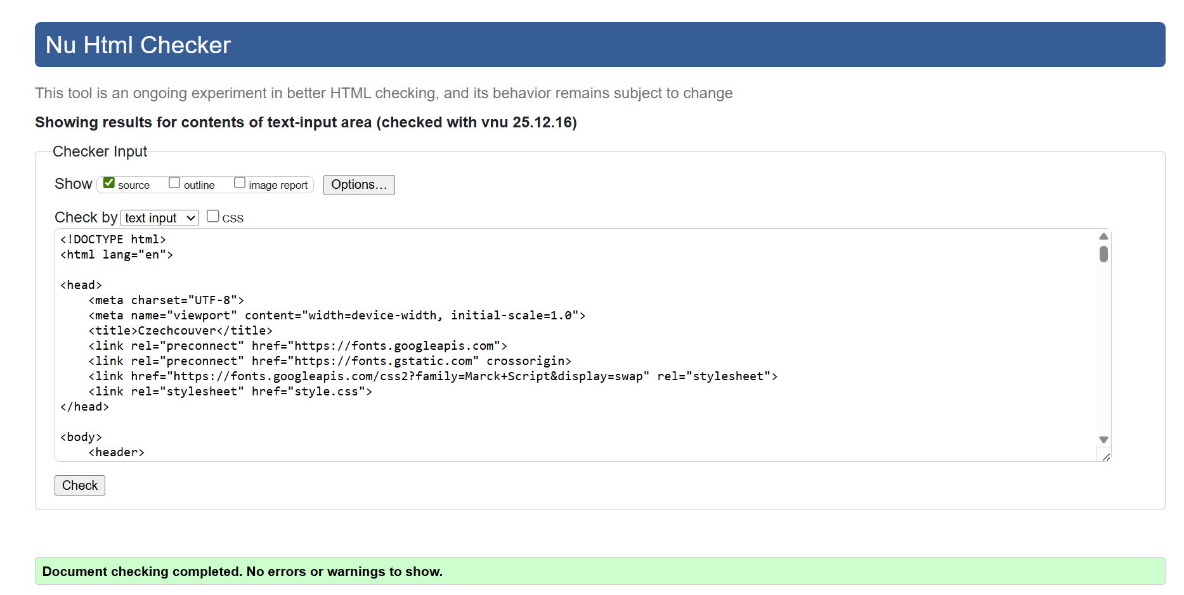
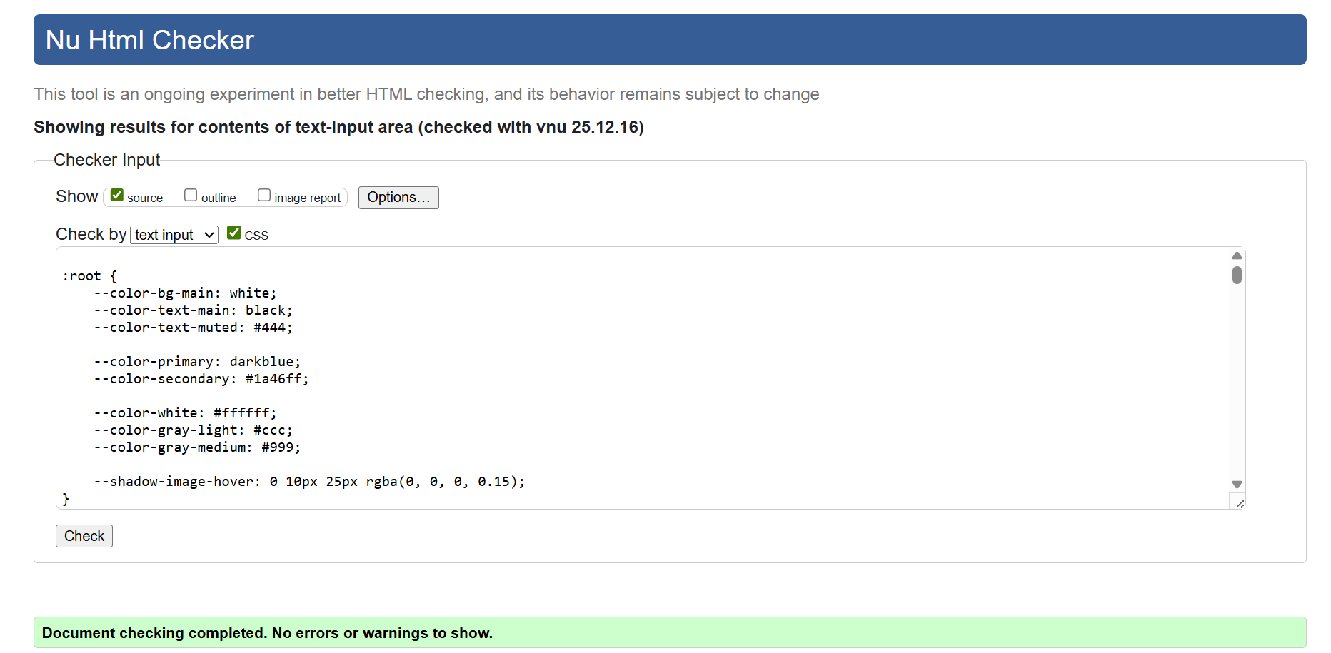
Responsive Web Development - Final Project
Vojtech Kousal - Czechcouver
W3C HTML & CSS Validation
23 of 32: Showcase W3C Code Validation
Answer these questions:
Show what results you get from W3C’s HTML Validator tools: https://validator.w3.org/
Show what results you get from W3C’s CSS Validator tools: https://jigsaw.w3.org/css-validator/

Slide 24
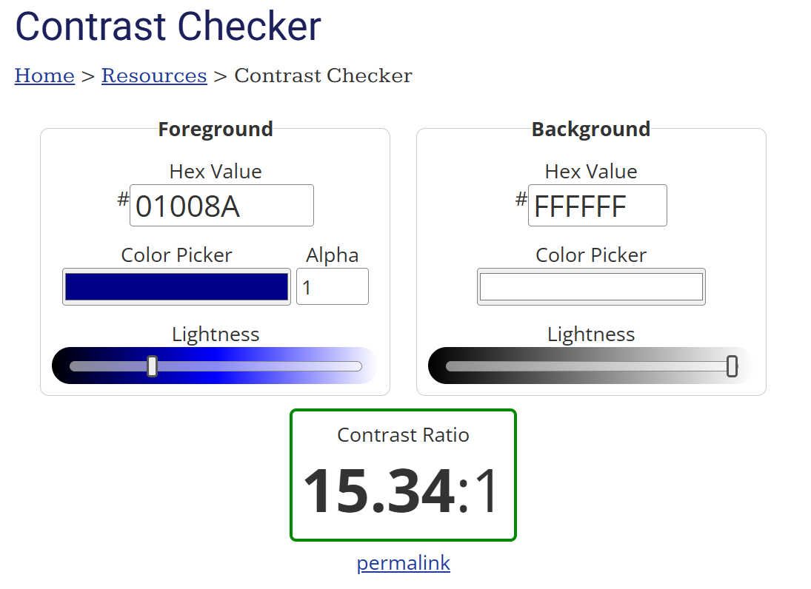
Responsive Web Development - Final Project
Vojtech Kousal - Czechcouver
WCAG Color Contrast Check
24 of 32: Showcase WCAG Color Contrast
Answer these questions:
Show what results you get from a WCAG color contrast checker when checking your background color with the text color.
Do you get AAA in regular text?
https://webaim.org/resources/contrastchecker/

Slide 25
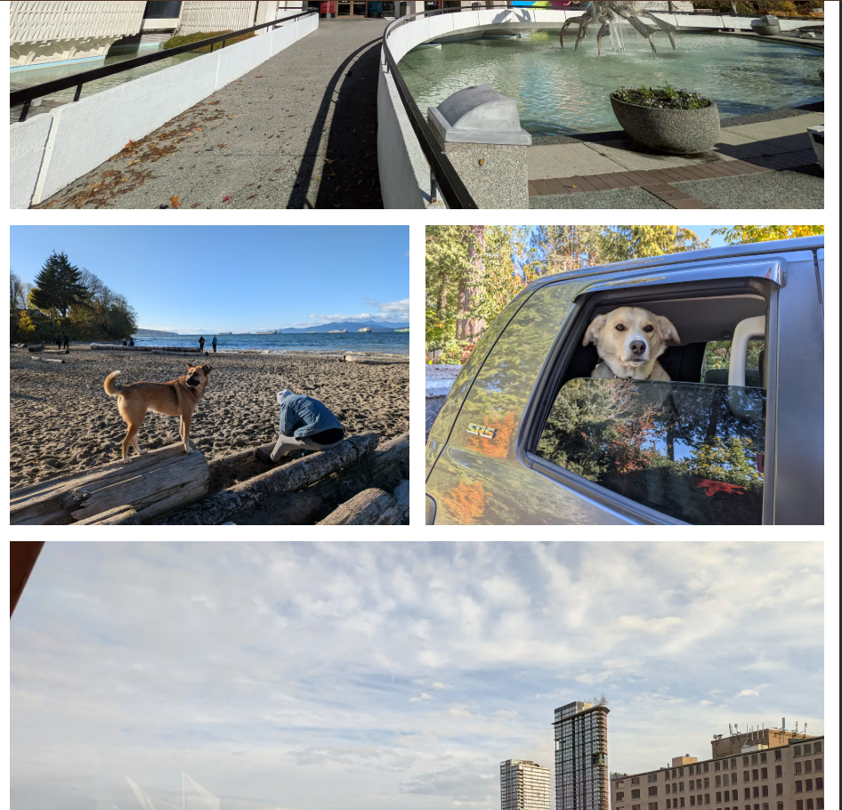
Responsive Web Development - Final Project
Vojtech Kousal - Czechcouver
Responsive Layouts
25 of 32: Showcase Responsive Site
Answer these questions:
Does your website adapt well for phone screens?
Does your website adapt well for tablet screens?
Does your website adapt well for desktop screens?

Slide 26
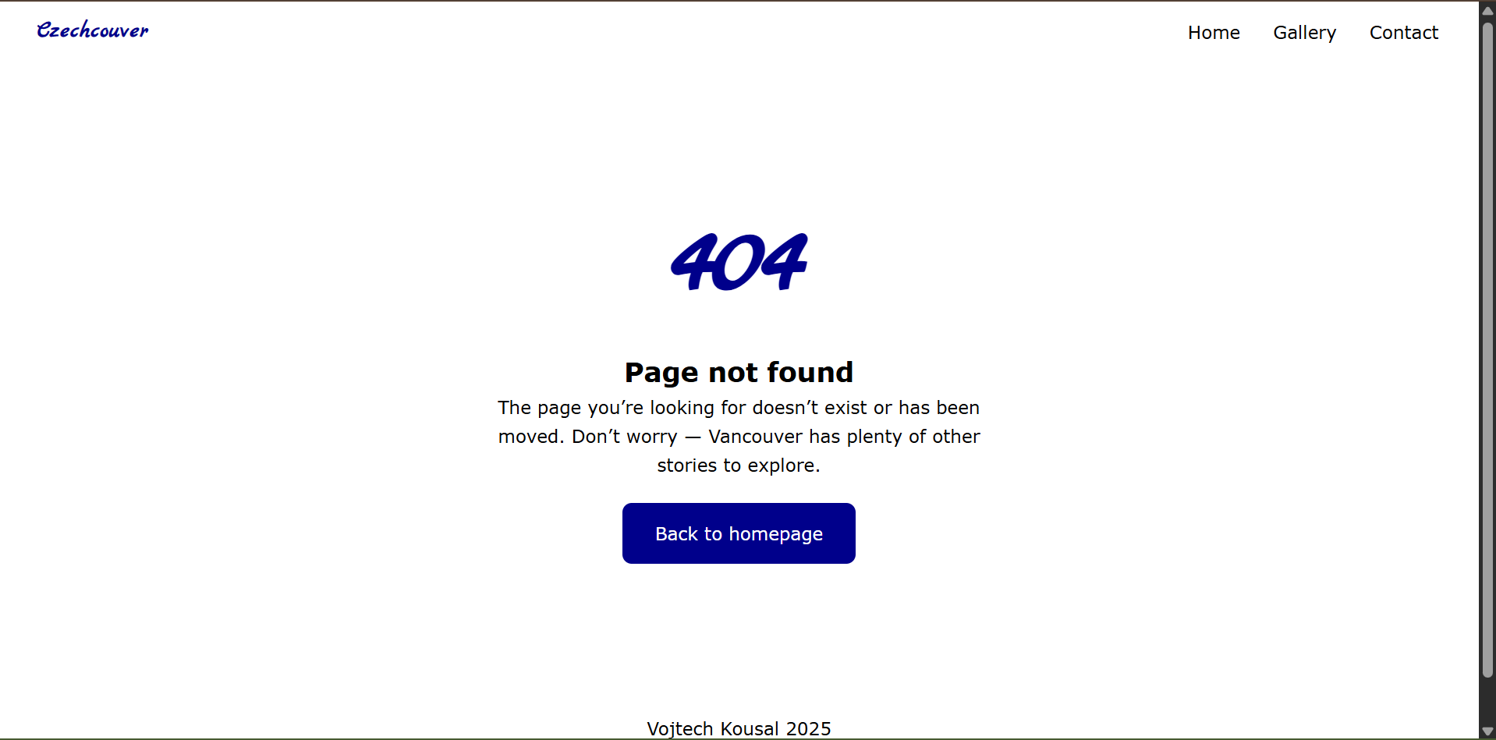
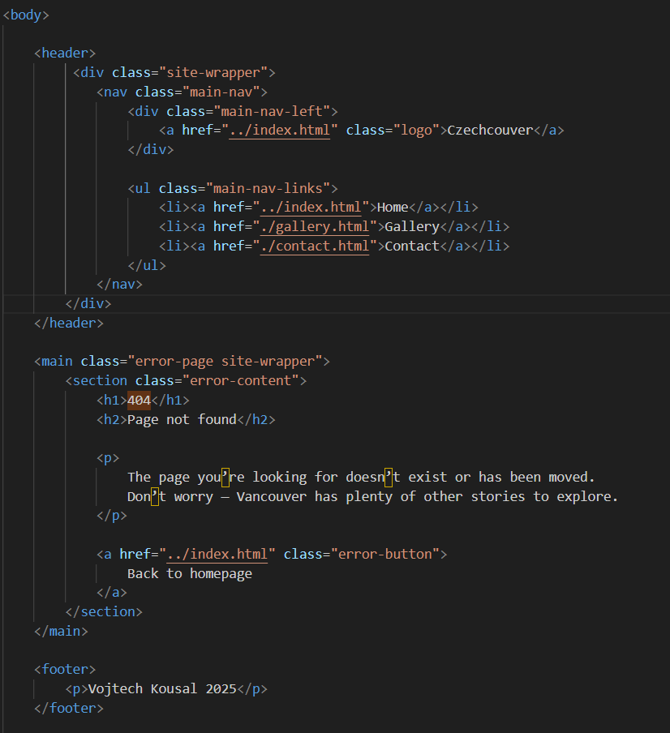
Responsive Web Development - Final Project
Vojtech Kousal - Czechcouver
404 Not Found Page
26 of 32: Showcase 404 Not Found Page
Answer these questions:
Did you include a 404 Not Found page?
Is your page html file named 404.html? If not why?
Does your 404 page tell the user what happened?
Can users navigate back home from the 404 page?

Slide 27
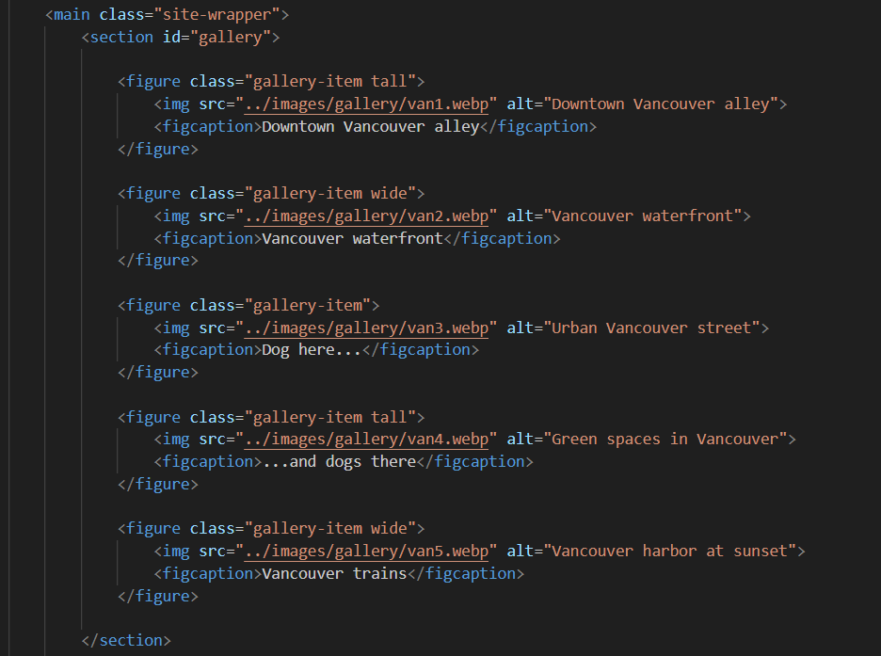
Responsive Web Development - Final Project
Vojtech Kousal - Czechcouver
Responsive Image Gallery
27 of 32: Showcase Responsive Image Gallery
Answer these questions:
Image galleries are common in websites, do you have an image gallery on your website?
Is your gallery responsive for smartphone, tablet, and desktop screens?

Slide 28
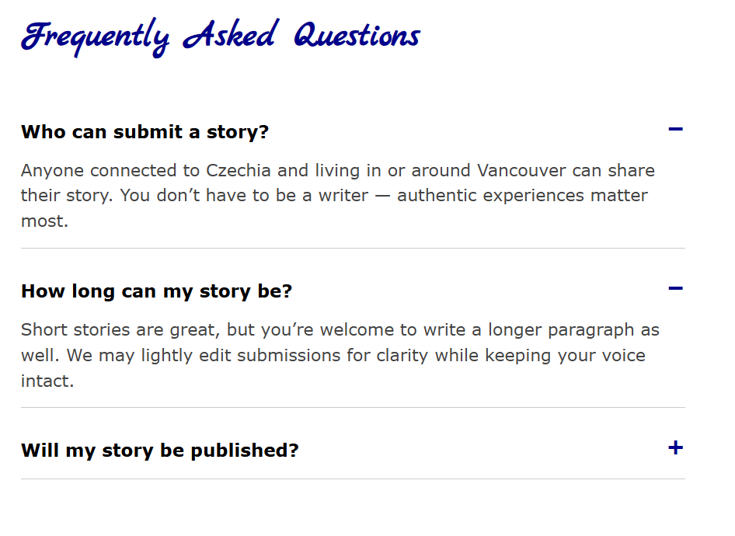
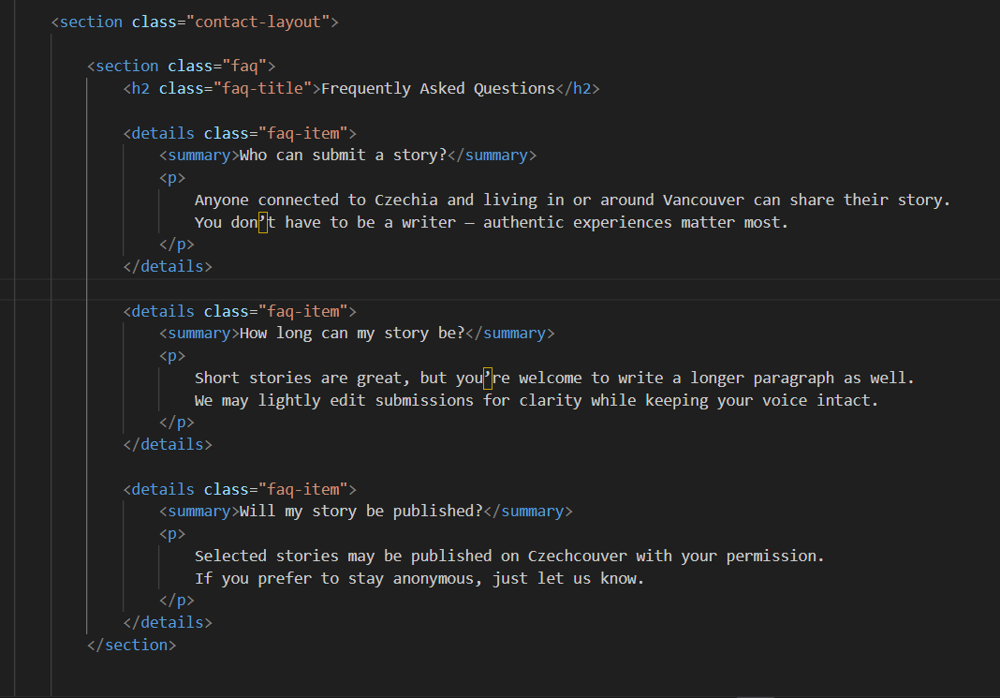
Responsive Web Development - Final Project
Vojtech Kousal - Czechcouver
FAQ Accordions
28 of 32: Showcase FAQ Accordions
Answer these questions:
Accordions and FAQs are common in websites, do you have an FAQ accordion on your website?

Slide 29

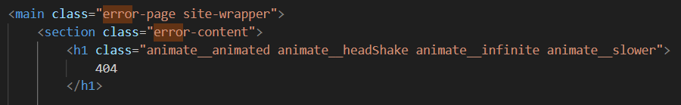
Responsive Web Development - Final Project
Vojtech Kousal - Czechcouver
CSS Library
29 of 32: Showcase CSS Library
Answer these questions:
Can you talk about what is Native CSS code in your project, what what is not?
Most of your CSS should be native code, however do you have an example of a CSS Library and how you used it in your project?

Slide 30
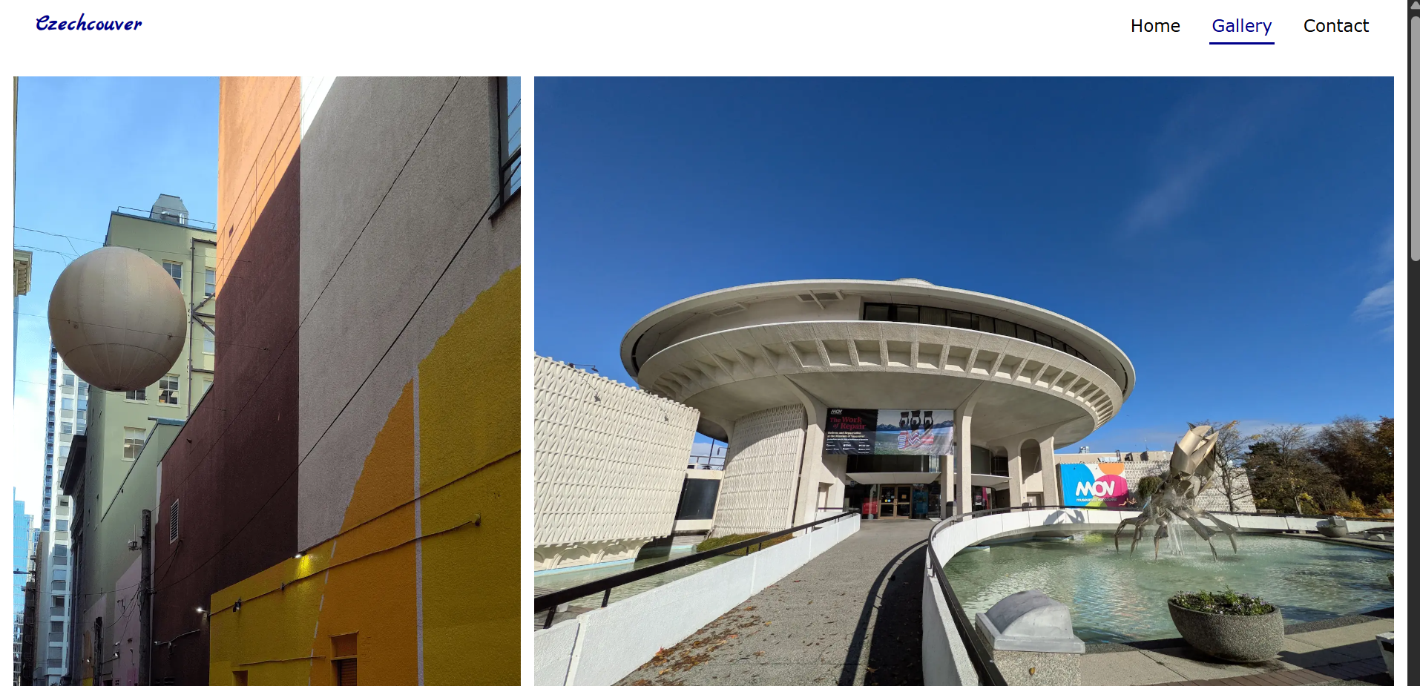
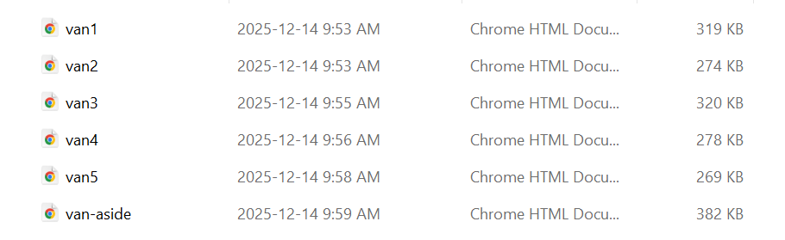
Responsive Web Development - Final Project
Vojtech Kousal - Czechcouver
Optimization: Images
30 of 32: Showcase Optimized Images
Answer these questions:
Did you use images with Webp format? If not why?
What is the file size of the images on your project?

Slide 31
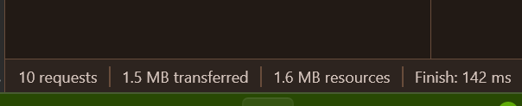
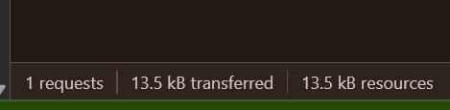
Responsive Web Development - Final Project
Vojtech Kousal - Czechcouver
Optimization: Total Page Size
31 of 32: Showcase Optimized Page Size
Answer these questions:
Does your website have a reasonable file size? (does not exceed 3MB per page)

Slide 32

Responsive Web Development - Final Project
Vojtech Kousal - Czechcouver
Biggest Challenge
32 of 32: Showcase your Biggest Challenge
Answer these questions:
What was your biggest challenge or struggle with the project so far?
If you overcame it, how did you do it?

